Slide 1
Tsinghua University Economic History and Development in Latin America Instructor: Prof. Lucas Llach (affiliation: Universidad Torcuato Di Tella, Argentina) Lecture 4/8. Globalization, Convergence and Divergence in Latin America (1870-1914)

Slide 2
Roadmap
Recap of the Independence Shock
First Globalization and Economic Performance
Institutional views
Endowment/Geographic theories
Dependency theories
First Globalization and the Internal Economy

Slide 3
Roadmap
Recap of the Independence Shock
First Globalization and Economic Performance
Insitutional views
Endowment/Geographic theories
Dependency theories
First Globalization and the Internal Economy

Slide 4
The shock of Independence
Some shocks:
"Imperial burden" (eg., Mexico)
Terms of trade shock (eg., Argentina): Price exports / Price imports.
Institutional Change?
Imperial disintegration and political conflict over who would be in charge.
Was It Shock or Continuity? (eg., Brasil v Argentina)
What else was happening at the same time?
Industrial Revolution in England

Slide 5
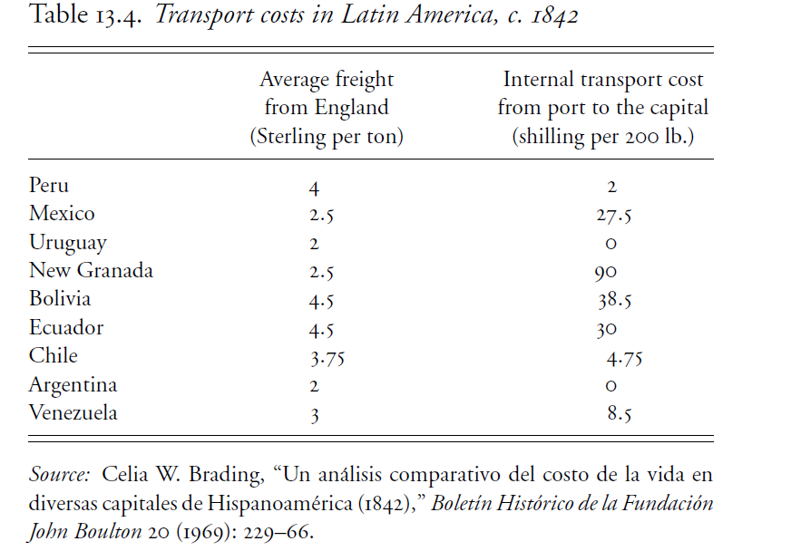
The shock of Independence: differential transport costs

Slide 6
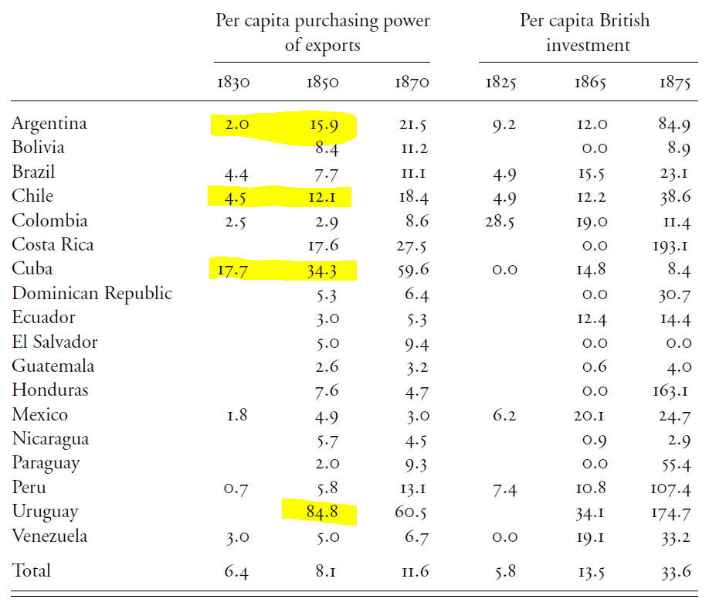
The shock of Independence: differential transport costs

Slide 7
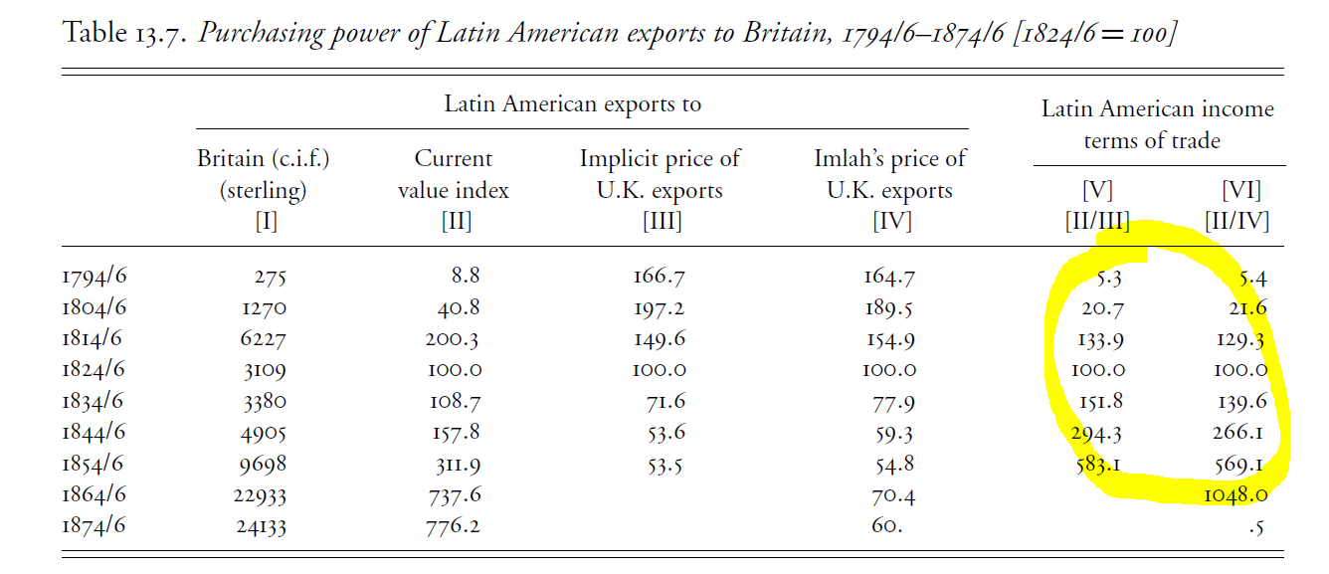
The shock of Independence: improvement of terms of trade

Slide 8
The Post-Independence Economy 1. Brazil
Still an "Empire" in spite of independence.
Slave plantations until the end of the 19th century.
Obstacles to industrialization:
If it was British dependence, it predated independence.
Brazilian authorities were autonomous (eg., slave trade) but were smart to avoid a very protectionist policy.
Brazil lacked other factors of production (technology, capital) for modern manufacture to develop.
Also: was there a market for large scale manufacturing, with high transport costs and low incomes?

Slide 9
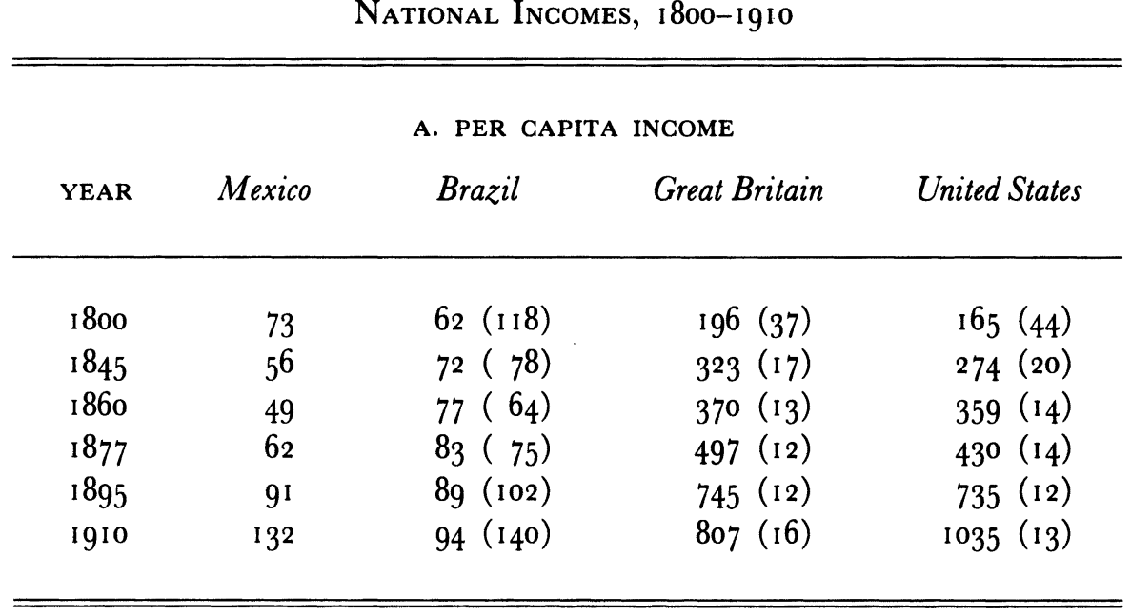
The Post-Independence Economy 2. Mexico

Slide 10
The Post-Independence Economy 2. Mexico
Marred by political conflict & low growth until the 1880s
Why?
Burden of Spanish colonial rule?
Land tenure?
The Church?
Maybe
Slow move to modern legal framework
Transport costs

Slide 11

The Post-Independence Economy 3. Argentina

Slide 12
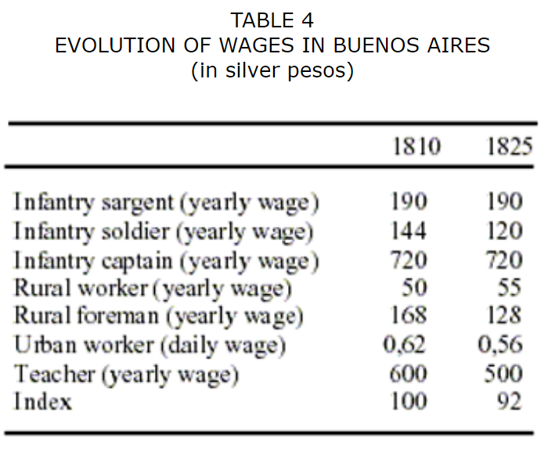
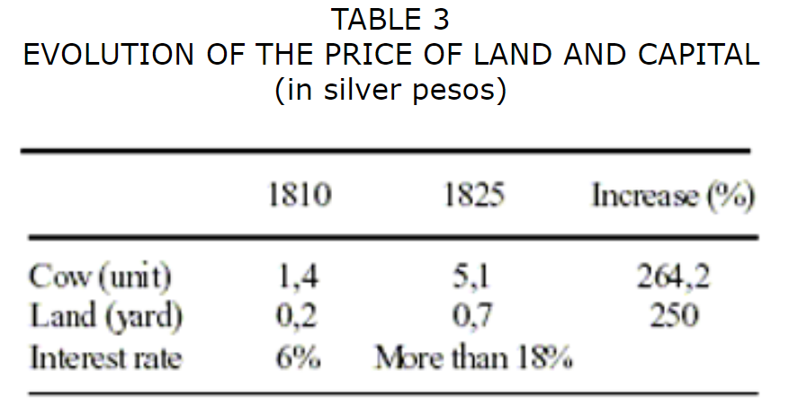
The Post-Independence Economy 3. Argentina
The more dynamic case of the three
"Disorder and Progress"
Huge terms of trade shock: effects on production (cattle) and on income distribution

Slide 13
Roadmap
Recap of the Independence Shock
First Globalization and Economic Performance
Insitutional views
Endowment/Geographic theories
Dependency theories
First Globalization and the Internal Economy

Slide 14


Slide 15


Slide 16
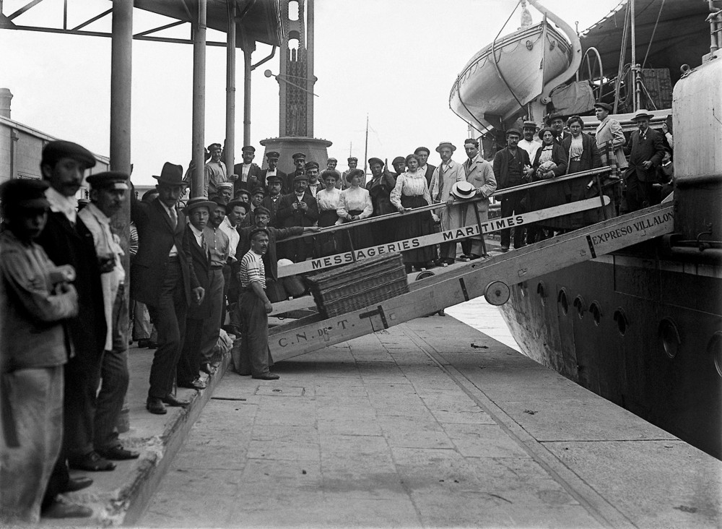

Slide 17
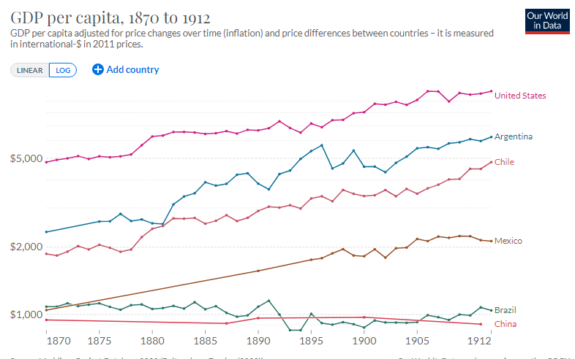
Roadmap

Slide 18
Roadmap
Recap of the Independence Shock
First Globalization and Economic Performance
Institutional views
Dependency theories
Endowment theories
First Globalization and the Internal Economy

Slide 19
Institutional Theories: Were Acemoglu / Engerman right?
Acemoglu/Robinson: do you get European people (with their "superior" institutions)? Without them, you may have growth, but not development.
Engerman/Sokoloff: do endowments generate an equal society?
Coatsworth: of course you need an elite, but you need an organized and stable one!

Slide 20
Institutional Theories: Were Acemoglu / Engerman right?
Coatsworth (reading list) nunanced institutionalist view
On Acemoglu/Engerman: LatAm wasn't *so* unequal
Transport costs to "highland" societies slowed progress
Imperial disintegration brought more problems than solutions.
Growth did come eventually, when elites organized "good" (but not "equal") institutions. This happened faster in "European" Latin American colonies.

Slide 21
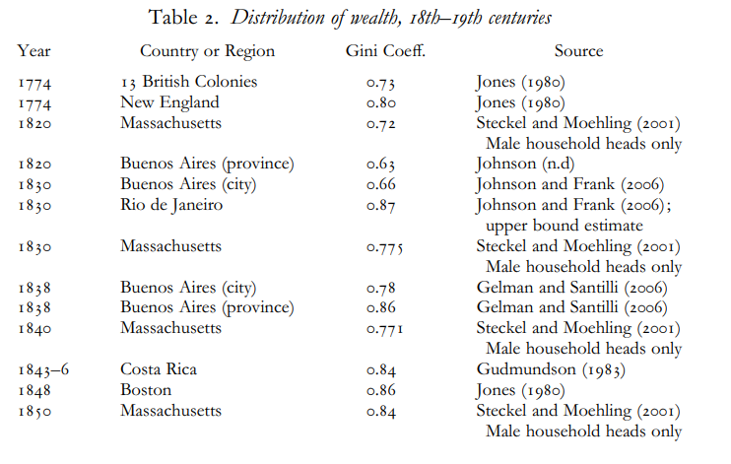
Institutional Theories: Were Acemoglu / Engerman right?

Slide 22
Roadmap
Recap of the Independence Shock
First Globalization and Economic Performance
Insitutional views
Endowment/Geographic theories
Dependency theories
First Globalization and the Internal Economy

Slide 23
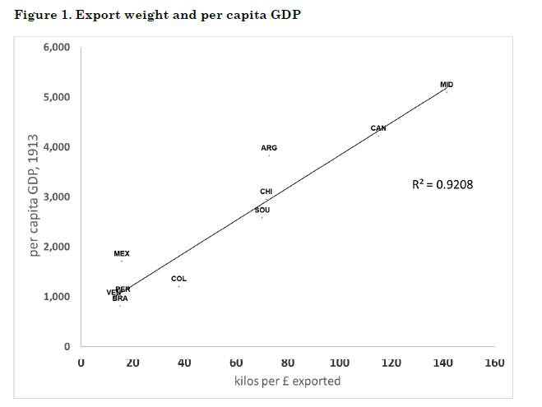
Endowment theories and Technological Luck

Slide 24
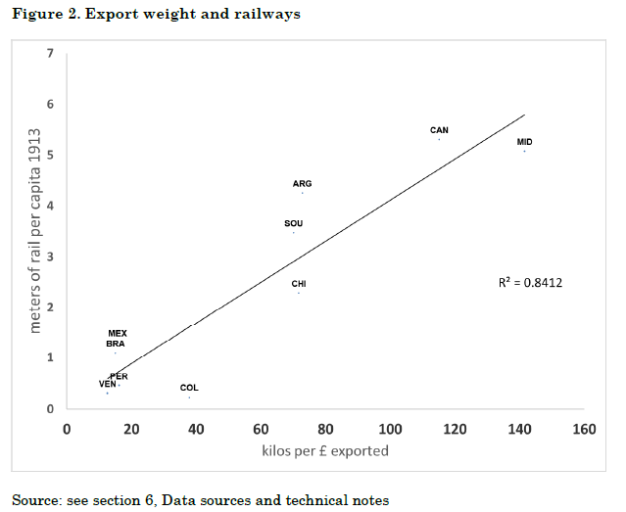
Endowment theories and Technological Luck

Slide 25
Endowment theories: Why Didn't LatAm industrialize, or Did It?
The Staple Theory and linkages from the export sector:
"forward linkages"
"backward linkages"
"demand linkages"
Did export-led growth slowed manufacturing growth?
What about the "terms of trade"?

Slide 26
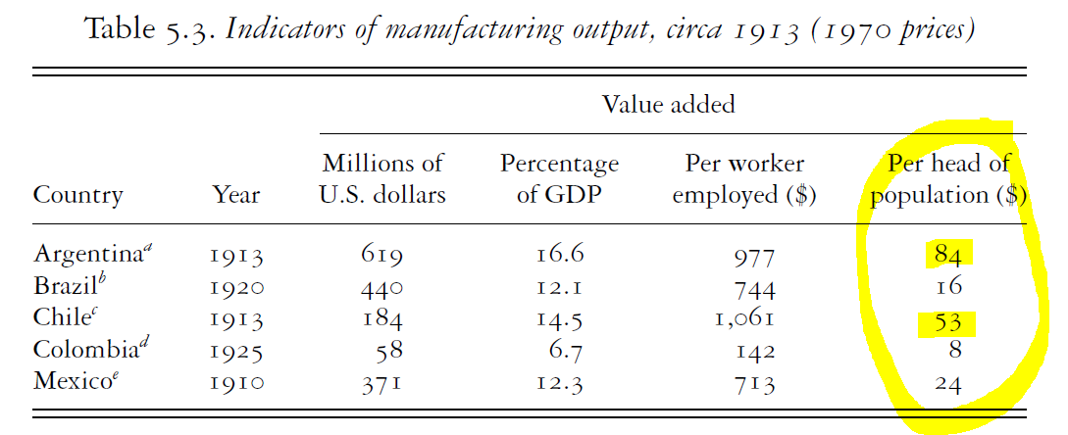
Endowment theories: Why Didn't LatAm industrialize, or Did It?

Slide 27
Roadmap
Recap of the independence Shock
First Globalization and Economic Performance
Insitutional views
Endowment/Geographic theories
Dependency theories
First Globalization and the Internal Economy

Slide 28
Dependency Theories & Export Pessimism
Yes, some economic growth but…
Political independence didn't end economic dependence
Terms of trade are tilted against LatAm & other developing economies
Crucial sectors of the economy controlled by foreign companies, and thus contribute little to local demand ("enclaves").
Big landowners not interested in diversifying into other sectors.
You won't get long term economic growth out of natural resources, as those can't be accumulated (and might even become depleted).
The Commodity Lottery

Slide 29
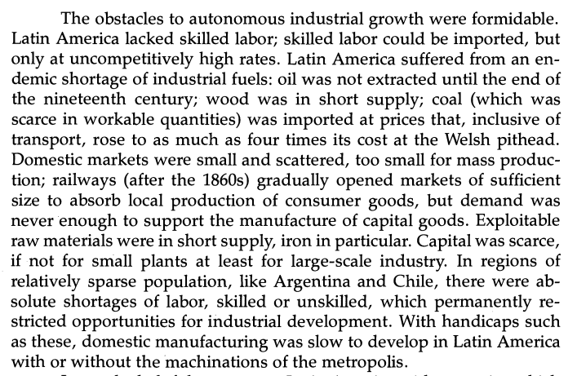
Was al alternative, "industrialized" road viable?
Source: DCM Platt, reading in Google Drive.

Slide 30
Roadmap
Recap of the Independence Shock
First Globalization and Economic Performance
Insitutional views
Endowment/Geographic theories
Dependency theories
First Globalization and the Internal Economy

Slide 31
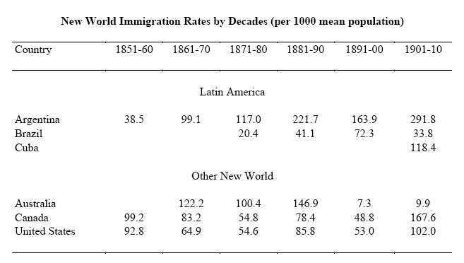
Migration and the new societies

Slide 32
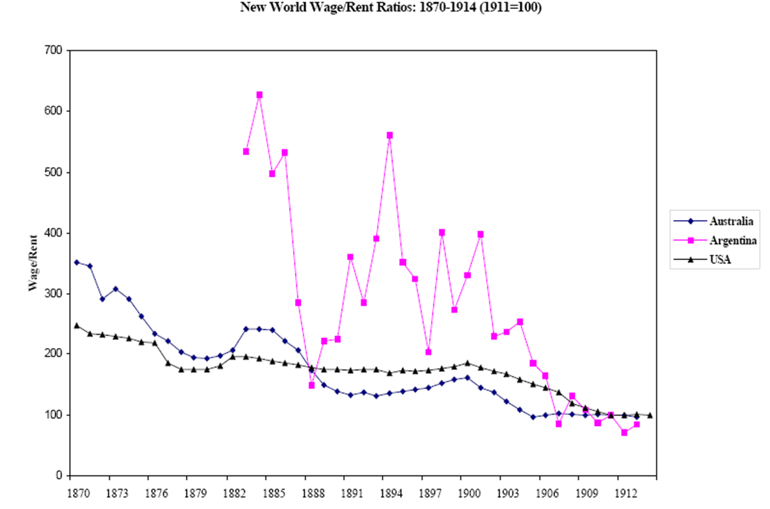
Factor endowments and factor prices

